Slide 1
UNIT-6
Searching
Linear Search Method.
Binary Search Method.
Sorting
Bubble Sort
Insertion Sort
Selection Sort
Quick sort
Merge sort
Performance analysis of Searching and Sorting Algorithms.

Slide 2
Linear Search:
Searching and Sorting
Searching is the process of finding a particular element in an array.
Sorting is the process of rearranging the elements in an array so that they
are stored in some well-defined order.
A linear or sequential search of an array begins at the beginning of the array
and continues until the item is found or the entire array has been searched.
  It is the basic searching technique.
  Very easy to implement
  The array DOESN’T have to be sorted.
  All array elements must be visited if the search fails.
  Could be very slow.

Slide 3
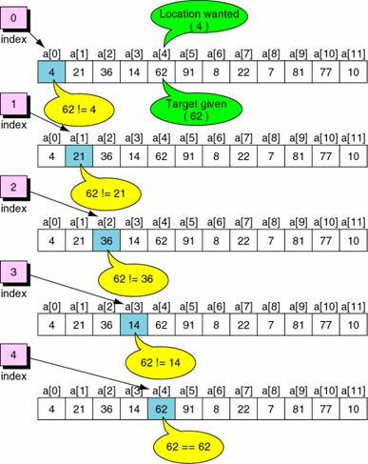
Example: Successful Linear Search

Slide 4
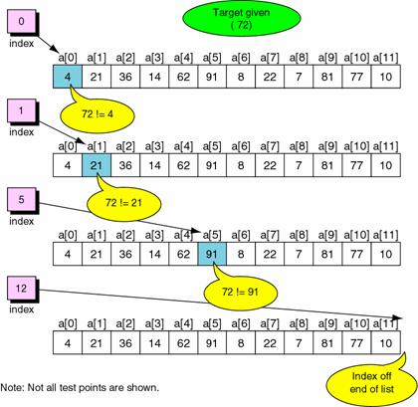
Example: Failed Linear Search

Slide 5
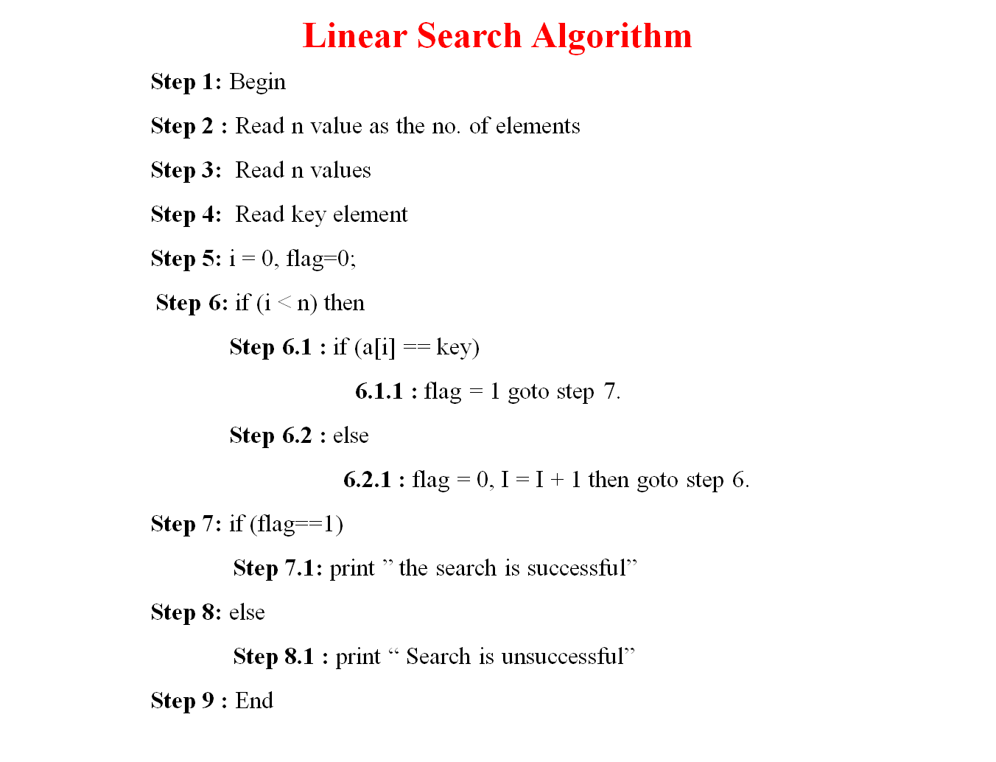

Slide 6
Linear Search Program
#include <stdio.h>
void main()
{
int a[10], key, i,n, count = 0;
printf("Enter the number of elements in array\n");
scanf("%d", &n);
printf("Enter %d numbers\n", n);
for ( i = 0 ; i < n ; i++ )
scanf("%d", &a[i]);
printf("Enter the number to search\n");
scanf("%d", &key);
for (i = 0; i < n; i++)
{
if (a[i] == key)
{
printf("%d is present at location %d.\n", key, i+1);
count++;
}
}
if (count == 0)
printf("%d is not present in array.\n", key);
else
printf("%d is present %d times in array.\n", key, count);
}

Slide 7
Linear Search Program using functions
#include<stdio.h>
int lsearch(int [], int, int);
void main()
{
int a[10], key, i, n, pos;
printf("Input number of elements in array\n");
scanf(“%d", &n);
printf("Input %d numbers\n", n);
for (i = 0; i < n; i++)
scanf("%ld", &a[i]);
printf("Input number to search\n");
scanf("%d",&key);
pos = lsearch(a, n, key);
if (pos == -1)
printf("%d is not present in array.\n", key);
else
printf("%d is present at location %d.\n", key, pos+1);
}
int lsearch(int a[], int n, int find)
{
int i;
for (i = 0 ;i < n ; i++ )
{
if (a[i] == find)
return i;
}
return -1
}

Slide 8
Linear Search using recursive functions
#include<stdio.h>
int lsearch(int [], int , int, int );
void main()
{
int a[10],i,key,pos=0,n;
printf(“enter number elments in an array\n”);
scanf(“%d”,&n);
printf("\n\nEnter %d integer elements: “,n);
for(i = 0; i < n; i++)
scanf("%d",&a[i]);
printf("\nEnter target element to be searched: ");
scanf("%d",&key);
pos = lsearch(a,pos,n,key);
if( pos != -1 )
printf("\nElement %d is found at %d location ",key,pos);
else
printf("Element is not found...");
}
int lsearch(int a[], int i,int n, int key)
{
if(i>n-1)
return -1;
else
if (a[i]==key)
return i;
else
return lsearch( a,i+1,n, key);
}

Slide 9
Binary Search: The search starts at the center of a sorted array, if center is equal to target element search is successful otherwise it determines which half to continue to search on that basis.
The algorithm starts searching with the mid element.
mid=(first + last)/2
  If the item is equal to mid then search is successful.
  If the item is less than the mid element, it starts over searching the first half of the list.
  If the item is greater than the mid element, it starts over searching the second half of the list.
  It then continues halving the list until the item is found.
Each iteration eliminates half of the remaining elements.
It is faster than the linear search.
It works only on SORTED array.
Thus, there is a performance penalty for sorting the array.

Slide 10
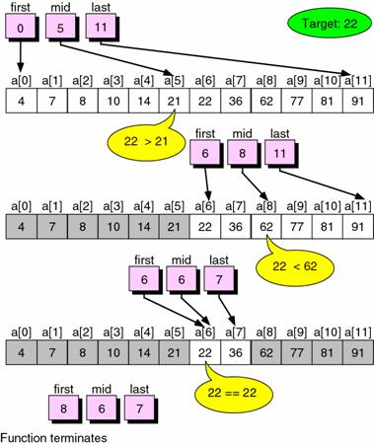
Example: Successful Binary Search

Slide 11
Binary Search Algorithm
Step 1 : Begin
Step 2 : Read n value as no of elements
Step 3 : Read n values as input
Step 4 : i=0,low=0,high = n-1
Step 5 : Read Key element
Step 6: if ( low <=high)
6.1 : mid = ( low + high ) / 2;
6.2 : if ( key < a[mid] )
high = mid - 1; goto Step6
6.3 : else if ( key > a[mid] )
low = mid + 1; goto Step6
6.4 : else
pos=mid;
break. goto Step 7
Step 7: if(pos>high)
Step 7.1 : pos = -1
Step 8 : if (pos != -1)
Step 8.1 : print “search Successful”
Step 9: else
Step 9.1 : print ”Sorry, search Unsuccessful”
Step 10 : End.

Slide 12
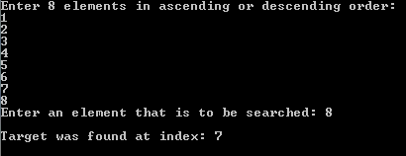
Non recursive program
#include <stdio.h>
int bsearch (int a[], int low, int high, int key);
void main() {
int a[15], key, pos,i,n;
printf(“Enter size of array”);
scanf(“%d”,&n);
printf("Enter %d elements in ascending or descending order: \n “,n);
for(i=0;i<n;i++)
scanf("%d",&a[i]);
printf("Enter an element that is to be searched: ");
scanf("%d", &key);
pos = bsearch(a, 0, n-1, key);
if (pos = -1)
printf("Sorry, target item was not found");
else
printf("\nTarget was found at index: %d ", pos);
}
int bsearch (int a[], int low, int high, int key)
{
int mid;
while (low <=high)
{
mid = ( low + high ) / 2;
if ( key ==a[mid] )
{
return mid;
}
else if ( key < a[mid] )
high = mid - 1;
else
low = mid + 1;
}
return -1;
}

Slide 13
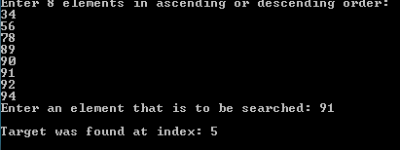
Recursive Program
#include <stdio.h>
int bsearch (int a[], int low, int high, int key);
void main()
{
int a[15], key, pos,i,n;
printf(“Enter size of array”);
scanf(“%d”,&n);
printf("Enter %d elements in ascending or descending order: \n“,n);
for(i=0;i<n;i++)
scanf("%d",&a[i]);
printf("Enter an element that is to be searched: ");
scanf("%d", &key);
pos = bsearch(a, 0, n-1, key);
if (pos == -1)\
printf("Sorry, target item was not found");
else
printf("\nTarget was found at index: %d ", pos);
}
int bsearch (int a[], int low, int high, int key)
{
int mid;
if (low > high)
return -1;
mid = (low + high)/2;
if (a[mid] == key)
return (mid);
else if (key<a[mid])
return bsearch(a,low,mid-1,key);
else
return bsearch(a,mid+1,high,key);
}

Slide 14
Binary Search vs Linear Search
Linear search, also known as the sequential search is the simplest search algorithm. It searches for a specified value in a list by checking every element in the list. Binary search is also a method used to locate a specified value in a sorted list. Binary search method halves the number of elements checked (in each iteration), reducing the time taken to locate the given item in the list.
What is Linear Search?
Linear search is the simplest searching method, which checks each element in a list sequentially until it finds a specified element. The input to the linear search method is a sequence (such as an array, collection or a string) and the item that needs to be searched. The output is true if the specified item is within the provided sequence or false if it is not in the sequence. Since this method checks every item in the list until the specified item is found, in the worst case it will go through all the elements in the list before it finds the required element. The complexity of linear search is o(n). Therefore it is considered to be too slow to be used when searching elements in large lists. But this is very simple and easier to implement.

Slide 15
What is Binary Search?
Binary search is also a method used to locate a specified item in a sorted list. This method starts by comparing the searched element to the elements in the middle of the list. If the comparison determines that the two elements are equal the method stops and returns the position of the element. If the searched element is greater than the middle element, it starts the method again using only the bottom half of the sorted list. If the searched element is less than the middle element, it starts the method again using only the top half of the sorted list. If the searched element is not within the list, the method will return a unique value indicating that. Therefore the binary search method halves the number of elements compared (in each iteration), depending on the result of the comparison. Consequently, binary search runs in logarithmic time resulting in o(log n) average case performance.
What is the difference between Binary Search and Linear Search?
Even though both linear search and binary search are searching methods they have several differences. While binary search operates on sorted lists, liner search can operate on unsorted lists as well. Sorting a list generally has an average case complexity of n log n. linear search is simple and straightforward to implement than the binary search. But, linear search is too slow to be used with large lists due to its o(n) average case performance. On the other hand, binary search is considered to be a more efficient method that could be used with large lists. But implementing the binary search could be quite tricky and a study has shown that the accurate code for binary search could be found in only five out of twenty books.

Slide 16
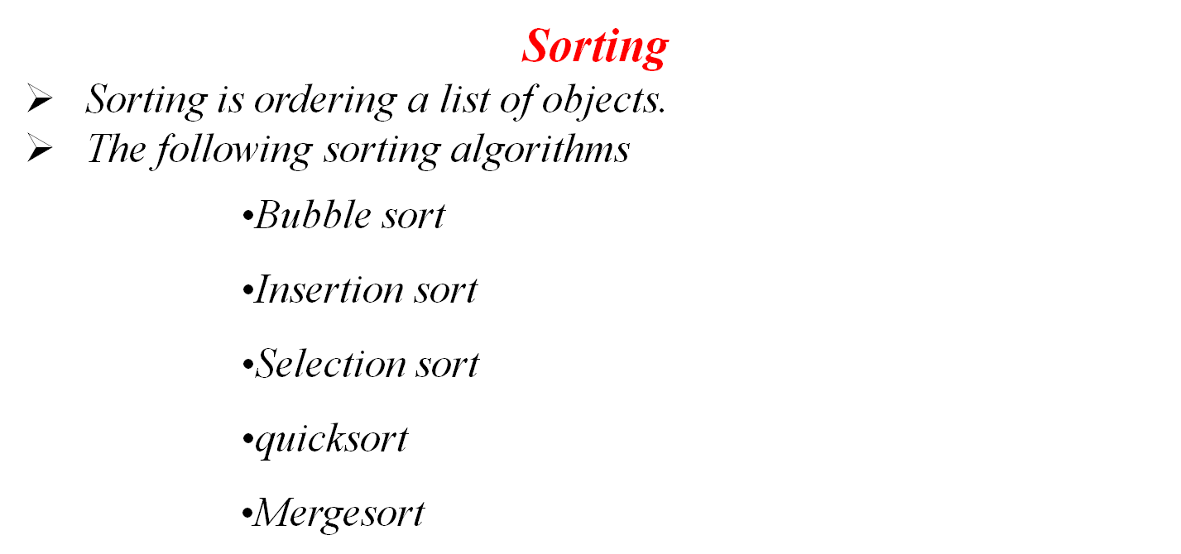

Slide 17
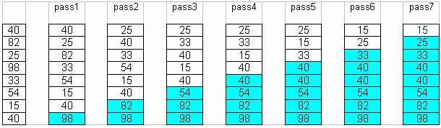
Bubble Sort
The idea of Bubble (or exchange) sort is to scan through the list and swap each pair of adjacent elements that are in the wrong order.
The process is repeated each time from index zero to one less than the previous limit until either the list is exhausted or until a pass that involve no swap is encountered.
At the end of first pass, the largest element will move (or bubble up) to the end of the list.
At the end of the second swap, the second largest will move to its right place, etc.
The following table shows a trace of how bubble sort works.

Slide 18
Bubble Sort Algorithm
Compare each element (except the last one) with its neighbor to the right
  If they are not in order,
  swap them, continue the same method until end of an array.
  This puts the largest element at the very end
  The last element is now in the correct and final place
Compare each element (except the last two) with its neighbor to the right
  If they are not in order,
  swap them, continue the same method until end of an array. This puts the second largest element next to last
  The last two elements are now in their correct and final places
Compare each element (except the last three) with its neighbor to the right
  Continue as above until you have no unsorted elements on the left

Slide 19
Bubble sort
Suppose the following numbers are stored in an array: 32,51,27,85,66,23,13,57
Pass-1
32 51 27 85 66 23 13 57 no swap
32 27 51 85 66 23 13 57
32 27 51 85 66 23 13 57 no swap
32 27 51 66 85 23 13 57
32 27 51 66 23 85 13 57
32 27 51 66 23 13 85 57
32 27 51 66 23 13 57 85
Pass-2
27 32 51 66 23 13 57 85
27 32 51 66 23 13 57 85 no swap
27 32 51 66 23 13 57 85 no swap
27 32 51 23 66 13 57 85
27 32 51 23 13 66 57 85
27 32 51 23 13 57 66 85
and so on…

Slide 20
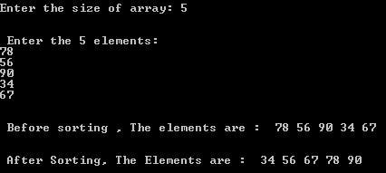
#include<stdio.h>
void bubbleSort(int a[],int n);
void main()
{
int n,a[10],i;
printf("\n\nEnter the size of array: ");
scanf("%d",&n);
printf("\n\n Enter the %d elements: \n",n);
for(i=0;i<n;i++)
scanf("%d",&a[i]);
printf("\n\n Before sorting , The elements are : ");
for(i=0;i<n;i++)
printf(" %d",a[i]);
printf("\n");
bubbleSort(a,,n);
}
void bubbleSort(int a[],int n)
{
int i,j,temp=0;
for(i=1;i<n;i++)
{
for (j=0;j<n-i;j++)
{
if(a[j]>a[j+1])
{
temp=a[j];
a[j]=a[j+1];
a[j+1]=temp;
}
}
}
printf("\n\n After Sorting, The Elements are : ");
for(i=0;i<n;i++)
printf(" %d",a[i]);
}

Slide 21
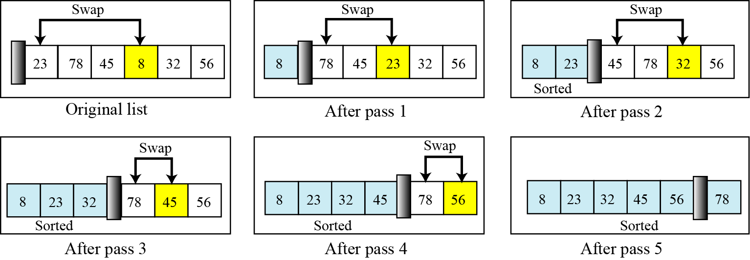
Selection Sort
Procedure:
Selection sort involved scanning through the list to find (or select) the smallest element and swap it with the first element.
The rest of the list is then search for the next smallest and swap it with the second element.
This process is repeated until the rest of the list reduces to one element, by which time the list is sorted.
The following table shows how selection sort works.

Slide 22
Selection Sort Algorithm
Given an array of length n,
  Search elements 0 through n-1 and select the smallest
    Swap it with the element in location 0
  Search elements 1 through n-1 and select the smallest
    Swap it with the element in location 1
  Search elements 2 through n-1 and select the smallest
    Swap it with the element in location 2
  Search elements 3 through n-1 and select the smallest
    Swap it with the element in location 3
  Continue in this fashion until there’s nothing left to search

Slide 23
Example:
Elements in the array before sorting: 77 33 44 55 88 66 22 11
pass-1 11 33 44 55 88 66 22 77
pass-2 11 22 44 55 88 66 33 77
pass-3 11 22 33 55 88 66 44 77
pass-4 11 22 33 44 88 66 55 77
pass-5 11 22 33 44 55 66 88 77
pass-6 11 22 33 44 55 66 88 77
pass-7 11 22 33 44 55 66 77 88
pass-8 11 22 33 44 55 66 77 88
Elements in the array before sorting: 11 22 33 44 55 66 77 88

Slide 24
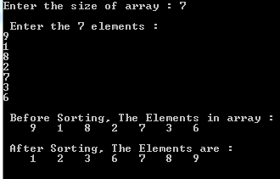
Selection Sort Program
#include<stdio.h>
void selectsort(int a[], int size);
int n,size,a[10],i,j,x,k,pass,temp,min,loc;
void main()
{
printf("\nEnter the size of array : ");
scanf("%d",&n);
printf("\n Enter the %d elements : \n",n);
for(i=0;i<n;i++)
scanf("%d",&a[i]);
printf("\n Before Sorting, The Elements in array :\n ");
for(i=0;i<n;i++)
printf("%4d",a[i]);
printf("\n");
selectsort(a,n);
printf("\n After Sorting, The Elements are :\n ");
for(i=0;i<n;i++)
printf("%4d",a[i]);
}
void selectsort(int x[],int n)
{
int temp,loc,k;
for(k=0;k<n;k++)
{
loc = findmin(x,k,n);
temp=x[k];
x[k]=x[loc];
x[loc]=temp;
}
}
int findmin(int x[],int k,int n)
{
min=x[k];
loc=k;
for(j=k+1;j<n;j++)
{
if(x[j]<min)
{
min=x[j];
loc=j;
}
}
return loc;
}

Slide 25
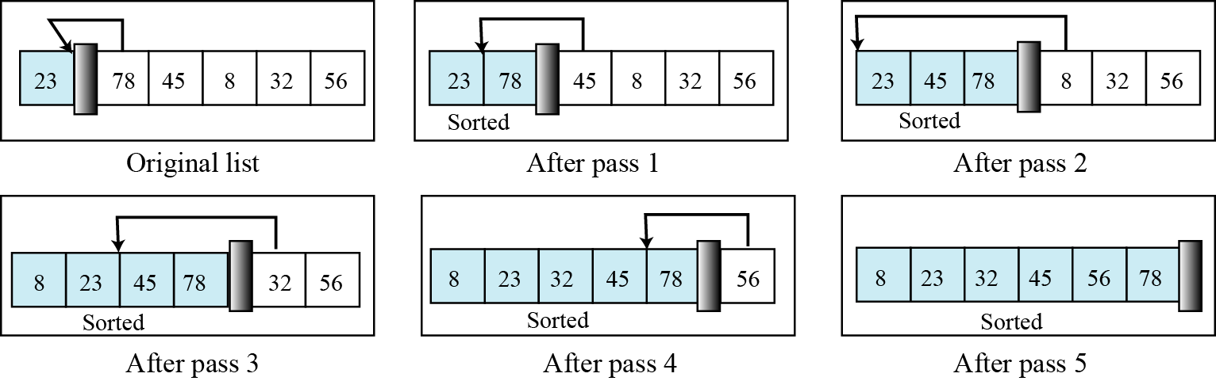
Insertion Sort
  Using insertion sort an element is inserted in correct location.
  Procedure:
  Begin with a sequence of n elements in arbitrary order
  Initially assume the sorted segment contains the first element.
  Let x be the next element to be inserted in sorted segment, pull x “out of the
  way”, leaving a vacancy.
  Repeatedly compare x to the element just to the left of the vacancy, and as long as x is smaller, move that element into the vacancy, else put x in the vacancy.
  Repeat the next element that has not yet examined.

Slide 26
Insertion Sort
To insert 12, we need to make room for it by moving first 36 and then 24.
6
10
24
36
12
Notes:
Sathi Durga Devi,Dept of IT

Slide 27
Insertion Sort
6
10
24
36
12
Notes:
Sathi Durga Devi,Dept of IT

Slide 28
Insertion Sort
6
10
24
36
12
Notes:
Sathi Durga Devi,Dept of IT

Slide 29
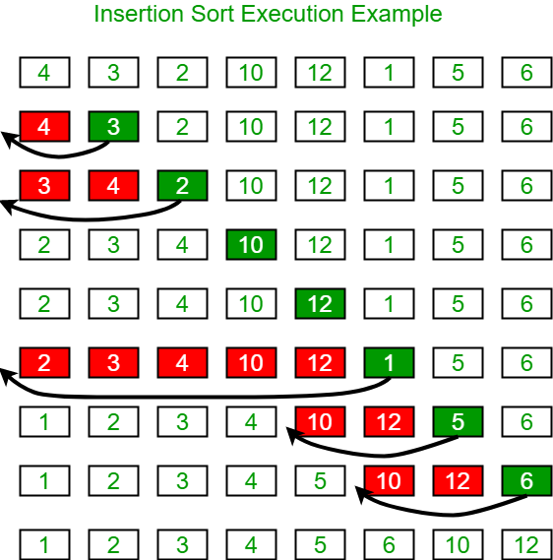

Slide 30
Example:
Elements in array before swapping: 77 33 44 11 88 22 66 55
pass-1 77 33 44 11 88 22 66 55
pass-2 33 77 44 11 88 22 66 55
pass-3 33 44 77 11 88 22 66 55
pass-4 11 33 44 77 88 22 66 55
pass-5 11 33 44 77 88 22 66 55
pass-6 11 22 33 44 77 88 66 55
pass-7 11 22 33 44 66 77 88 55
pass-8 11 22 33 44 55 66 77 88
Elements in array after sorting: 11 22 33 44 55 66 77 88

Slide 31
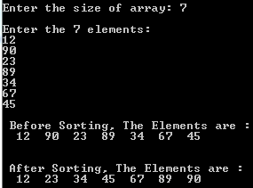
#include<stdio.h>
void insertionsort(int a[],int size);
void main()
{
int n,a[10],i;
printf("\nEnter the size of array: ");
scanf("%d",&n);
printf("\nEnter the %d elements: \n",n);
for(i=0;i<n;i++)
scanf("%d",&a[i]);
printf("\n Before Sorting, The Elements are : \n");
for(i=0;i<n;i++)
printf("%4d",a[i]);
printf("\n");
insertionsort(a,n);
printf("\n\n After Sorting, The Elements are : \n");
for(i=0;i<n;i++)
printf("%4d",a[i]);
}
void insertionsort(int a[],int n)
{
int i,j,temp;
for(i=0;i<n;i++)
{
temp=a[i];
for (j=i-1;(j>=0)&&(temp<=a[j]);j--)
a[j+1]=a[j];
a[j+1]=temp;
}
}

Slide 32
Quicksort
In this method, an element called pivot is identified and that element is fixed in its place by moving all the elements less than that to its left and all the elements greater than that to its right.
Procedure:
If array only contains one element, return it.
Else
  Pick one element to use as pivot.
  Partition elements into two sub-arrays
    Elements less than or equal to pivot
    Elements greater than pivot
  Quicksort two sub-arrays.
  4. Return results.

Slide 33
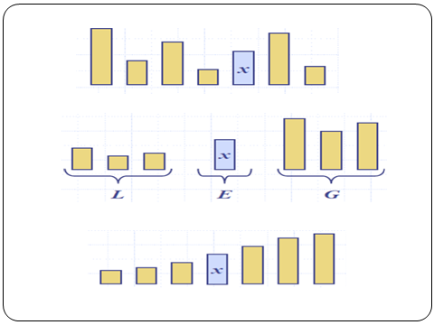
pivot = 0
40
20
10
80
60
50
7
30
100
[0] [1] [2] [3] [4] [5] [6] [7] [8]
i
j
While data[i] <= data[pivot]
++i
40
20
10
80
60
50
7
30
100
pivot= 0
[0] [1] [2] [3] [4] [5] [6] [7] [8]
i
j

Slide 34
pivot= 0
40
20
10
80
60
50
7
30
100
[0] [1] [2] [3] [4] [5] [6] [7] [8]
i
j
Pivot=0
40
20
10
80
60
50
7
30
100
[0] [1] [2] [3] [4] [5] [6] [7] [8]
i
j
40
20
10
80
60
50
7
30
100
[0] [1] [2] [3] [4] [5] [6] [7] [8]
i
j

Slide 35
While data[i] <= data[pivot]
  ++i
While data[j] > data[pivot]
  --j
40
20
10
80
60
50
7
30
100
[0] [1] [2] [3] [4] [5] [6] [7] [8]
if i < j
swap data[i] and data[j]
i
j
40
20
10
80
60
50
7
30
100
[0] [1] [2] [3] [4] [5] [6] [7] [8]
i
j
40
20
10
30
60
50
7
80
100
[0] [1] [2] [3] [4] [5] [6] [7] [8]
i
j

Slide 36
While data[i] <= data[pivot]
  ++i
While data[j] > data[pivot]
  --j
If i < j
  swap data[i] and data[j]
While j > i, go to 1.
pivot_index = 0
40
20
10
30
60
50
7
80
100
[0] [1] [2] [3] [4] [5] [6] [7] [8]
i
j
pivot_index = 0
40
20
10
30
60
50
7
80
100
[0] [1] [2] [3] [4] [5] [6] [7] [8]
i
j

Slide 37
40
20
10
30
60
50
7
80
100
[0] [1] [2] [3] [4] [5] [6] [7] [8]
i
j
While data[i] <= data[pivot]
  ++i
While data[j] > data[pivot]
  --j
If i < j
  swap data[i] and data[j]
While j > i, go to 1.
40
20
10
30
60
50
7
80
100
[0] [1] [2] [3] [4] [5] [6] [7] [8]
i
j

Slide 38
40
20
10
30
60
50
7
80
100
[0] [1] [2] [3] [4] [5] [6] [7] [8]
i
j
While data[i] <= data[pivot]
  ++i
While data[j] > data[pivot]
  --j
If i < j
  swap data[i] and data[j]
While j > i, go to 1.
40
20
10
30
60
50
7
80
100
[0] [1] [2] [3] [4] [5] [6] [7] [8]
i
j

Slide 39
40
20
10
30
7
50
60
80
100
[0] [1] [2] [3] [4] [5] [6] [7] [8]
i
j
While data[i] <= data[pivot]
  ++i
While data[j] > data[pivot]
  --j
If i < j
  swap data[i] and data[j]
While j > i, go to 1.
40
20
10
30
7
50
60
80
100
[0] [1] [2] [3] [4] [5] [6] [7] [8]
i
j

Slide 40
40
20
10
30
7
50
60
80
100
[0] [1] [2] [3] [4] [5] [6] [7] [8]
While data[i] <= data[pivot]
  ++i
While data[j] > data[pivot]
  --j
If i < j
  swap data[i] and data[j]
While j > i, go to 1.
i
j
pivot_index = 0
40
20
10
30
7
50
60
80
100
[0] [1] [2] [3] [4] [5] [6] [7] [8]
i
j

Slide 41
40
20
10
30
7
50
60
80
100
[0] [1] [2] [3] [4] [5] [6] [7] [8]
i
j
While data[i] <= data[pivot]
  ++i
While data[j] > data[pivot]
  --j
If i < j
  swap data[i] and data[j]
While j > i, go to 1.
40
20
10
30
7
50
60
80
100
[0] [1] [2] [3] [4] [5] [6] [7] [8]
i
j

Slide 42
While data[i] <= data[pivot]
  ++i
While data[j] > data[pivot]
  --j
If i < j
  swap data[i] and data[j]
While j > i, go to 1.
40
20
10
30
7
50
60
80
100
[0] [1] [2] [3] [4] [5] [6] [7] [8]
While data[i] <= data[pivot]
  ++i
While data[j] > data[pivot]
  --j
If i < j
  swap data[i] and data[j]
While j > i, go to 1.
Swap data[j] and data[pivot_index]
i
j
40
20
10
30
7
50
60
80
100
[0] [1] [2] [3] [4] [5] [6] [7] [8]
i
j

Slide 43
Partition Result
While data[i] <= data[pivot]
  ++i
While data[j] > data[pivot]
  --j
If i < j
  swap data[i] and data[j]
While j > i, go to 1.
Swap data[j] and data[pivot_index]
7
20
10
30
40
50
60
80
100
pivot_index = 4
[0] [1] [2] [3] [4] [5] [6] [7] [8]
i
j
7
20
10
30
40
50
60
80
100
Recursion: Quicksort Sub-arrays
[0] [1] [2] [3] [4] [5] [6] [7] [8]
7
20
10
30
40
50
60
80
100
[0] [1] [2] [3] [4] [5] [6] [7] [8]
<= data[pivot]
> data[pivot]
<= data[pivot]
> data[pivot]

Slide 44
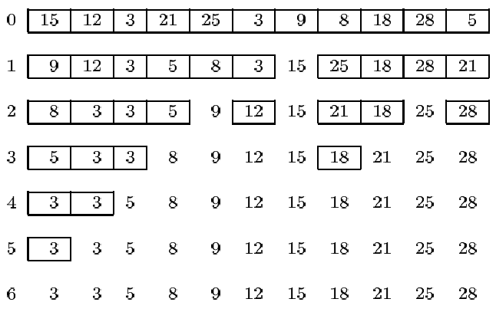
Recursive implementation with the left most array entry selected as the pivot element.

Slide 45
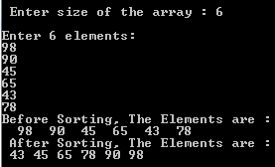
#include<stdio.h>
void quicksort(int [10],int,int);
int main()
{
int a[20],n,i;
printf("\n Enter size of the array : ");
scanf("%d",&n);
printf("\nEnter %d elements: \n",n);
for(i=0;i<n;i++)
scanf("%d",&a[i]);
printf("Before Sorting, The Elements are : \n");
for(i=0;i<n;i++)
printf("%4d",a[i]);
quicksort(a,0,n-1);
printf("\n After Sorting, The Elements are : \n");
for(i=0;i<n;i++)
printf(" %d",a[i]);
return 0;
}
void quicksort(int a[10],int first,int last)
{
int pivot,j,temp,i;
if(first<last)
{
pivot=first;
i=first;
j=last;
while(i<j)
{
while(a[i]<=a[pivot]&&i<last) i++;
while(a[j]>a[pivot]) j--;
if(i<j)
{
temp=a[i];
a[i]=a[j];
a[j]=temp;
}
}//while
temp=a[pivot];
a[pivot]=a[j];
a[j]=temp;
quicksort(a,first,j-1);
quicksort(a,j+1,last);
}//if
}

Slide 46
Why merge sort?
Merge sort isn’t an “in place” sort—it requires extra storage
However, it doesn’t require this storage “all at once”
This means you can use merge sort to sort something that doesn’t fit in memory—say, 300 million census records—then much of the data must be kept on backup media, such as a hard drive
Merge sort is a good way to do this
Using merge sort for large data sets
Very roughly, here’s how to sort large amounts of data:
  Repeat:
    Read in as much data as fits in memory
    Sort it, using a fast sorting algorithm (quicksort may be a good choice)
    Write out the sorted data to a new file
  After all the data has been written into smaller, individually sorted files:
    Read in the initial portion of each sorted file into individual arrays
    Start merging the arrays
    Whenever an array becomes empty, read in more data from its file
    Every so often, write the destination array to the (one) final output file
When you are done, you will have one (large) sorted file

Slide 47
Merge Sort
In this method, the elements are divided into partitions until each partition has sorted elements.
Then, these partitions are merged and the elements are properly positioned to get a fully sorted list.
Procedure/Algorithm:
1. Split array A[0..n-1] into about equal halves and make copies of each half in
arrays B and C.
2. Sort arrays B and C recursively.
3. Merge sorted arrays B and C into array A as follows:
  3.1. Repeat the following until no elements remain in one of the arrays:
    3.1.1 Compare the first elements in the remaining unprocessed portions of the arrays.
    3.1.2 Copy the smaller of the two into A, while incrementing the index indicating the unprocessed portion of that array.
    3.2 Once all elements in one of the arrays are processed, copy the remaining unprocessed elements from the other array into A.

Slide 48
Example 1:
mergesort(a,0,7)
8
3
2
9
7
1
5
4
mergesort(a,0,3)
mergesort(a,4,7)
8
3
2
9
7
1
5
4
mergesort(a,0,1)
mergesort(a,2,3)
mergesort(a,4,5)
mergesort(a,6,7)
8
3
2
9
7
1
5
4
ms(a,0,0)
ms(a,1,1)
ms(a,2,2)
ms(a,3,3)
ms(a,4,4)
ms(a,5,5)
ms(a,6,6)
ms(a,7,7)
8
3
2
9
7
1
5
4
merge(a,0,1,0)
merge(a,2,3,2)
merge(a,4,5,4)
merge(a,6,7,6)
3
8
2
9
1
7
4
5
merge(a,0,3,1)
merge(a,4,7,5)
2
3
8
9
1
4
5
7
merge(a,0,7,3)
1
2
3
4
5
7
8
9

Slide 49
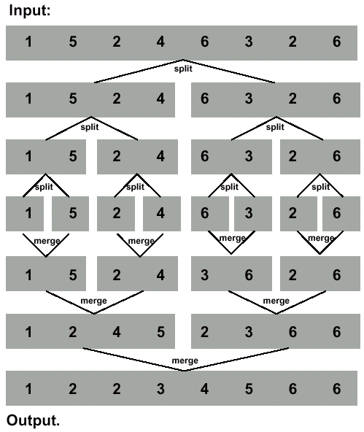
Example 2:

Slide 50
#include <stdio.h>
#include <stdlib.h>
void merge(int [],int,int,int);
void mergesort(int [],int,int);
void main()
{
int i,n,a[100];
printf("\n Enter the size of the array :");
scanf("%d",&n);
printf("\n Enter the %d elements :\n",n);
for(i = 0; i < n; i++)
scanf("%d",&a[i]);
printf("\n Before Sorting, The Elements are : \n");
for(i = 0; i < n; i++)
printf("%4d",a[i]);
mergesort(a,0,n-1);
printf("\n After Sorting, The Elements are :\n");
for(i = 0; i < n; i++)
printf("%4d",a[i]);
}

Slide 51
void mergesort(int a[],int low,int high)
{
int mid;
if(low < high)
{
mid = (low + high)/2;
mergesort(a,low,mid);
mergesort(a,mid+1,high);
merge(a,low,high,mid);
}
}
void merge(int a[],int L,int h,int m)
{
int c[100],i,j,k;
i = L; j = m + 1; k = L;
while(i <= m && j <= h)
{
if(a[i] < a[j])
{
c[k] = a[i]; i++; k++;
}
else
{
c[k] =a[j]; j++; k++;
}
}
while(i <= m) c[k++] = a[i++];
while(j <= h) c[k++] = a[j++];
for(i = L; i < k; i++) a[i] = c[i];
}

Slide 52
    Performance Analysis of Searching and sorting Techniques
Analysis Of Linear Search
Best case: The best case occurs when the search term is in the first slot in the array. The number of comparisons in this case is 1.
Worst case: The worst case occurs when the search term is in the last slot in the array, or is not in the array. The number of comparisons in this case is equal to the size of the array. If our array has N items, then it takes N comparisons in the worst case.
Average case: On average, the search term will be somewhere in the middle of the array. The number of comparisons in this case is approximately N/2
In both the worst case and the average case, the number of comparisons is proportional to the number of items in the array, N. Thus, we say in these two cases that the number of comparisons is O(N)
In the best case, we say the number of comparisons is O(1)

Slide 53
Analysis Of Binary Search
Best case: The best case occurs when the search term is in the first slot in the array. The number of comparisons in this case is 1.
Worst case: In Binary search, the worst case occurs, when we have to keep reducing the search space till it has only one element. The worst-case time complexity of Binary search is O(logn).
Average case: On average, the search term will be somewhere in the middle of the array O(logn) .
In both the worst case and the average case, the number of comparisons is proportional to the number of items in the array, N. Thus, we say in these two cases that the number of comparisons is O(log n)
In the best case, we say the number of comparisons is O(1)

Slide 54
Analysis of bubble sort
for (i=1; i<n; i++)
{
for (j = 0; j < n-i; j++)
{
if (a[j] > a[j + 1])
{ // code for swap omitted }
}
}
Each time the outer loop(i) is executed, the inner loop is executed
  Inner loop (j) executes n-1 times at first, linearly dropping to just once
  Inner loop (j) executes n-2 times at seccond pass and so on
  .............. .
  -Inner loop (j) executes 1 time at last pass
  Total number of times of execution of inner loop is(n-1)+(n-2)+…..+2+1
  n(n-1)/2
  In the inner loop, the comparison is always done (constant time), the swap might be done (also constant time)
Result is O(n2/2 + k) = O(n²)
you should recognize Best,worst,avg as O(n²)

Slide 55
Analysis of selection sort
for(i=0;i<n;i++)
{
loc=findmin(a,i,n)
swap a[i] and swap a[loc]
}
Each time the outer loop(i) is executed, the inner loop is executed to find smallest element from array
  Inner loop executes n-1 times at first to find smallest element
  Inner loop executes n-2 times at second pass to find smallest element
  .............. .
  -Inner loop executes 1 time at last pass to find the smallest element
  Total number of times of execution of inner loop is (n-1)+(n-2)+…..+2+1
  =n(n-1)/2
The comparison is always done (constant time), the swap might be done (also constant time)
Result is O(n2/2 + k) = O(n²)
you should recognize Best,worst,avg as O(n²)

Slide 56
Analysis of insertion sort
for(i=1;i<n;i++)
{ temp=a[i];
for(j=1-1;j>=0&&temp<=a[j];j--)
a[j+1]=a[j];
a[j+1]=temp }
Each time the outer loop(i) is executed, the inner loop is executed
  Inner loop (j) executes 1 time at first, Inner loop (j) executes 2 times at second pass , Inner loop (j) executes 3 times at third pass and so on
  .............. .
  -Inner loop (j) executes n-1 times at last pass
  Total number of times of execution of inner loop is 1+2+3…….+(n-1) n(n-1)/2
The comparison is always done (constant time), the swap might be done (also constant time)
Result is O(n2/2 + k) = O(n²)
you should recognize worst,avg as O(n²⁾
Best case: The best case of sorting is elements are in sorted order. In this case inner loop never executed,only outer loop executed for n times.
Best as o(n)

Slide 57
Merge Sort Analysis
Most of the sorting techniques we have discussed are O(n²)
As we will see later, we can do much better than this with somewhat more complicated sorting algorithms
Within O(n²),
  Bubble sort is very slow, and should probably never be used for anything
  Selection sort is intermediate in speed
  Insertion sort is usually faster than selection sort—in fact, for small arrays (say, 10 or 20 elements), insertion sort is faster than more complicated sorting algorithms
  Merge sort, if done in memory, is O(n log n)
Selection sort and insertion sort are “good enough” for small arrays
Merge sort is good for sorting data that doesn’t fit in main memory

Slide 58
Big O Notation
  Indicates, how hard an algorithm has to work to solve a problem.
Time Complexities of Searching & Sorting Algorithms:
 | Best Case | Average Case | Worst Case
Linear Search | O(1) | O(n) | O(n)
Binary Search | O(1) | O(log n) | O(log n)
Bubble Sort | O(n²) | O(n²) | O(n²)
Selection Sort | O(n²) | O(n²) | O(n²)
Insertion Sort | O(n) | O(n²) | O(n²)
Merge Sort | O(n log n) | O(n log n) | O(n log n)
Quick Sort | O(n log n) | O(n log n) | O(n²)

